Slide 1


CORPORATE
PROFILE
2026
www.oandg-solutions.com

Slide 2
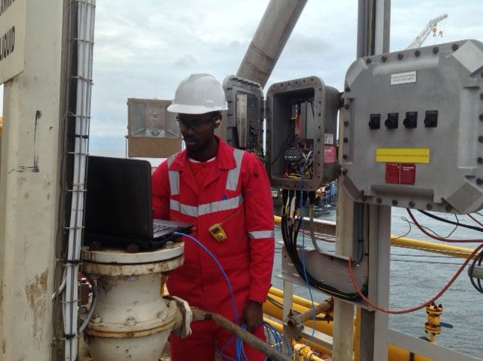
Executive Overview
03
Vision, Mission, Values, & Our Behaviour
04
Company & Governance
06
Products & Services
07
Execution Philosophy & Technical Capability
09
HSE, Quality, Nigerian Content, Supply Chain
13
Table of Contents
Projects, Clients, Licenses, ESG
17
Why O&G, Other Projects & Contact
23

Slide 3
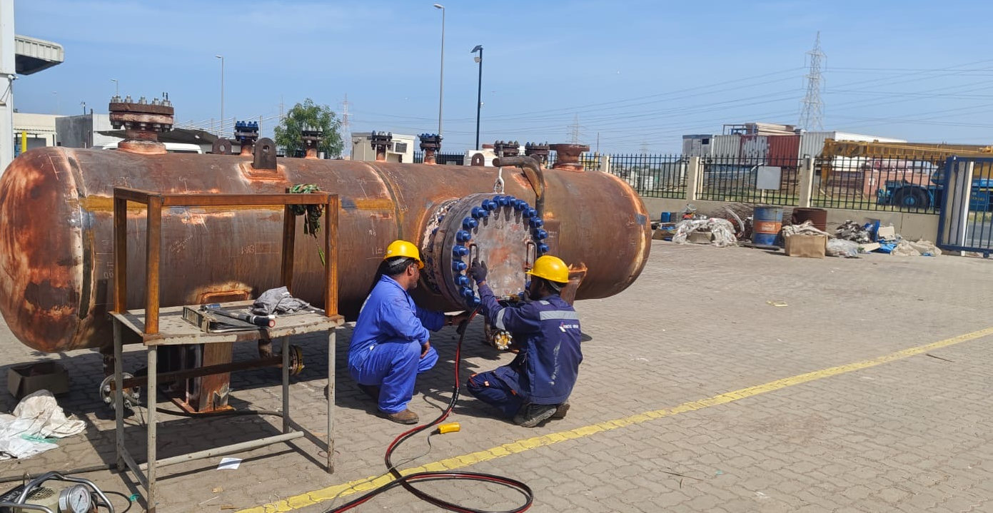
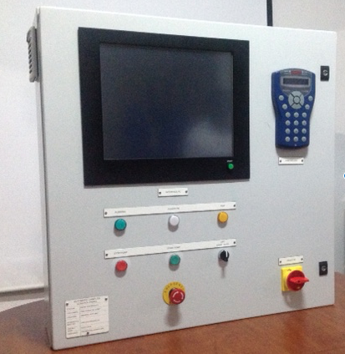

Executive Overview
O&G Solutions Ltd is a specialist engineering and process systems company delivering modular oil and gas facilities across Nigeria and the Middle East, with a focus on Early Production Facilities (EPFs), utility packages, skid-mounted process, and integrated EPC delivery.
As an execution-led package integrator, we combine in-country delivery experience in Nigeria with a fabrication footprint in the Middle East — bridging design, procurement, fabrication, and site execution to deliver schedule certainty and rapid monetisation of hydrocarbon assets.

Slide 4



Vision, Mission & Values
Our Vision
Excellence
To be a leading provider of modular process systems for oil and gas operations across Africa and the Middle East.
Delivery excellence and a determination to surpass our customers’ expectations underpin everything we do.
Our Mission
Performance & Innovation
To deliver safe, high-quality, innovative and efficient engineering solutions tailored to each client’s needs.
Consistent performance sets us apart, while innovation drives our search for better solutions to our clients’ problems.

Slide 5
Our behaviour
Champion Safety
Embrace Teamwork
Be Accountable
Drive Innovation
We strive to be at the forefront of safety, in everything we do.
We work together to deliver an excellent service – we coach and learn from others.
We take responsibility for and pride in our actions.
We inspire and innovate with purpose to seek out solutions for every challenge.
Partner Customers
Communicate Effectively
Think
Planet
Deliver
Quality
We build and sustain high value partnerships with our customers and colleagues.
Effective communication is key. We share information and respect everyone we work with.
We commit to reduce our environmental footprint and improve our local impact.
We focus on delivering operational excellence to all our stakeholders.

Slide 6

Company Background
Corporate Structure & Governance
Founded in Nigeria in 2005 and expanded to the UAE in 2022, O&G Solutions has grown into a dual-region execution company serving upstream operators across offshore platforms, FPSOs, MOPUs, and onshore flow stations.
O&G Solutions operates under a structured governance framework with defined leadership, reporting lines, and accountability. The company maintains compliance with regulatory and industry standards, ensuring transparency and operational integrity across every project.
We combine engineering design and fabrication capability in the UAE with project execution in Nigeria, enabling fast-track delivery of modular EPF systems supporting developments from 15,000 to 30,000 BLPD.

Slide 7
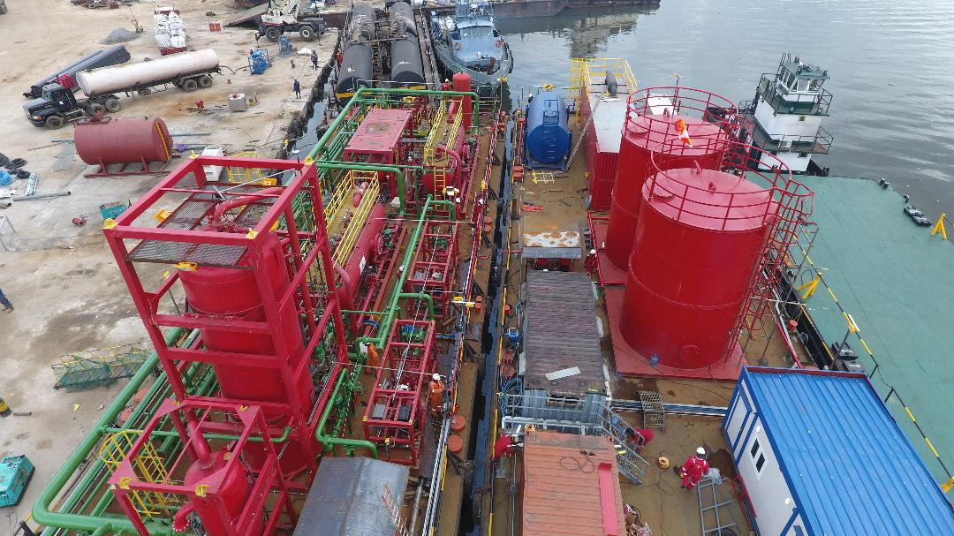
Product Lines
01
Engineering Solutions
02
Utilities
Solutions
03
Emission Control Solutions
O&G Solutions delivers a focused portfolio of modular engineering, utilities, measurement, and emission control solutions tailored to upstream operators across Africa and the Middle East.
04
Facilities Solutions
05
Measurement Solutions
06
Well site
solutions

Slide 8




Core Products & Services
EPF Modules
Up to
30,000 BLPD
Well Test Separators
The following modular EPF packages have been engineered, fabricated, and delivered to upstream operators across Africa and the Middle East. All systems are delivered under ISO 9001 aligned management systems.
We maintain a strict health and safety system under ISO 14001 and ISO 4500
Class
600# & 900#
Surge tanks (single and dual compartments
Class 150#
Choke Manifolds
15K
Psig
Pipeline pump packages
10KBPD
& 30K BPD
Services Execution and local content
Site construction support
Site construction support — Up to 250 specialists worldwide
NCDMB-compliant local workforce development
Fast-track modular installation
Up to 250
Disciplined engineers

Slide 9

Project Execution Philosophy
Modular Execution
Proven Capacity
Modular fabrication reduces site installation duration and shortens project schedules.
Production from 5,000 to 25,000 BOPD, 5,000 BWPD and gas handling up to 30 MMSCFD.
Our execution model is centred on modularisation — reducing site work, integrating engineering, procurement, fabrication, and commissioning into a seamless workflow, and accelerating speed-to-first oil.
Parallel Engineering
Fast Schedules
Early procurement of long-lead items combined with parallel engineering streams.
Fast-track EPF deployments in swamp terrain and brownfield re-entry environments.

Slide 10
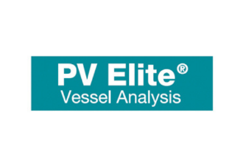
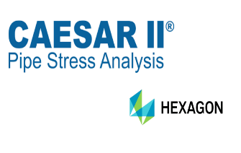

Technical Capability
Process & Piping
Structural
Electrical
Instrumentation
Skid and pipe-rack structural design engineered for transport, installation, and service loads.
Process design, P&IDs, piping layouts and equipment specification to ASME and API standards.
Power distribution, MCC and VFD systems engineered to IEC standards and hazardous-area requirements.
Integrated control, ESD and F&G systems designed for reliable upstream operation across asset types.

Slide 11

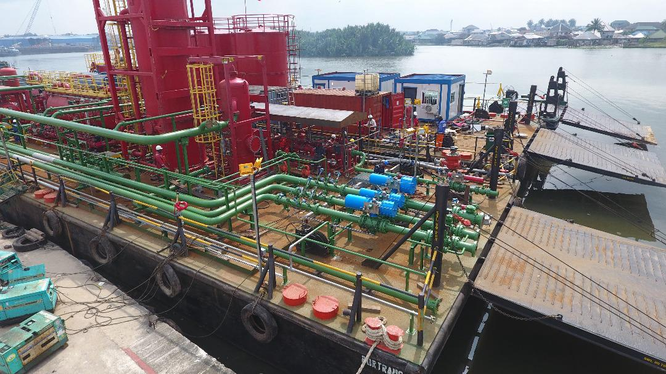
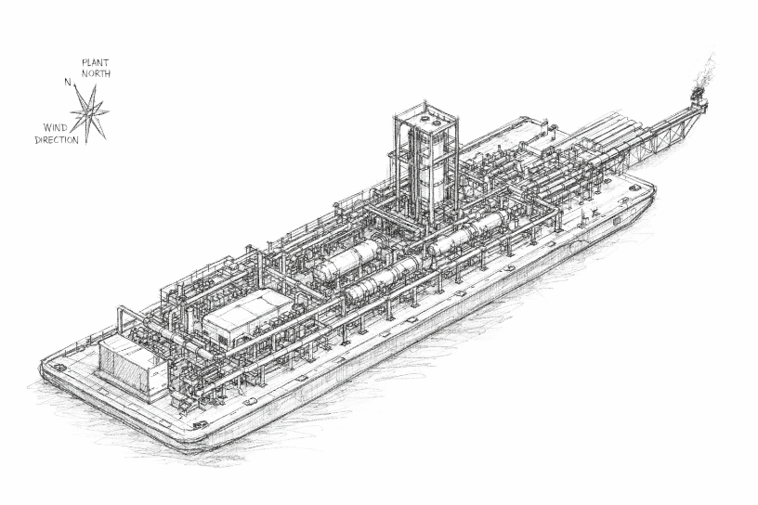
Equipment & Fabrication Facilities
Port Harcourt Yard
Certified Equipment
A leased equipment yard in Port Harcourt supporting skid fabrication, piping, structural works, and assembly for Nigerian projects.
All pressure vessels and modular systems delivered with full certification, material traceability, and third-party inspection.
UAE Fabrication Partners
Collaboration with UAE-based partners for DNV 2.7-1 and ASME U-Stamp certified pressure vessels and modular packages.

Slide 12
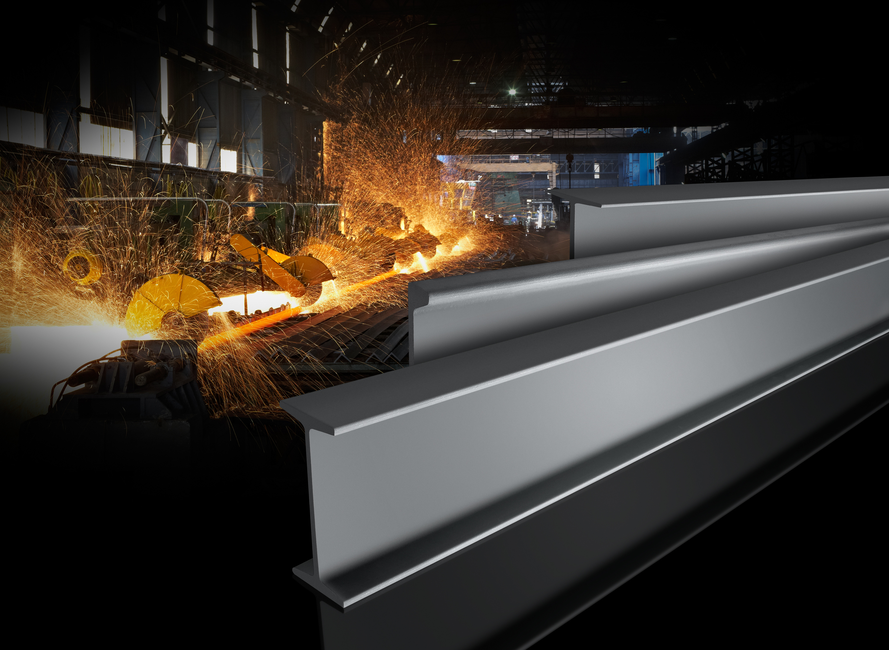
SLIDE
BREAK
Any questions?
www.oandg-solutions.com

Slide 13

HSE Management
ISO-Aligned Systems
Risk Management
Goal
Zero
Continuous Improvement
Risk assessments, method statements, and Permit-to-Work systems applied to all fabrication and site activities.
HSE culture aligned with ISO 45001 and ISO 14001 principles, integrated across every project phase.
Five consecutive years of zero Lost-Time Incidents, underpinned by structured TRIR and LTIFR tracking.
Incident prevention, lessons-learned reviews, and continuous improvement embedded in our delivery model.

Slide 14
Quality Management
Quality Management System structured in line with ISO 9001 principles across engineering, fabrication, and delivery.
Full document control from material certificates to as-built documentation, ensuring traceability through to handover.
ISO 9001 Aligned
Inspection Test Plans
Defined QA/QC procedures covering inspection, non-conformance handling, and corrective action across every workstream.
Project-specific Inspection Test Plans and hold points jointly agreed with client and third-party inspectors.
QA/QC Procedures
Document Control

Slide 15
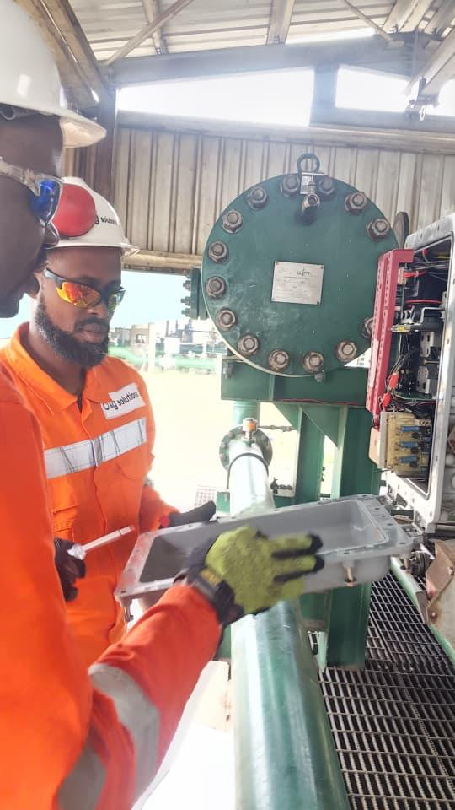

Nigerian Content Commitment
O&G Solutions is committed to local content development in line with NCDMB requirements. Our operations prioritise Nigerian workforce development, in-country fabrication, and engagement of qualified local vendors — building long-term capability within the Nigerian oil and gas sector while supporting our clients’ compliance obligations.

Slide 16
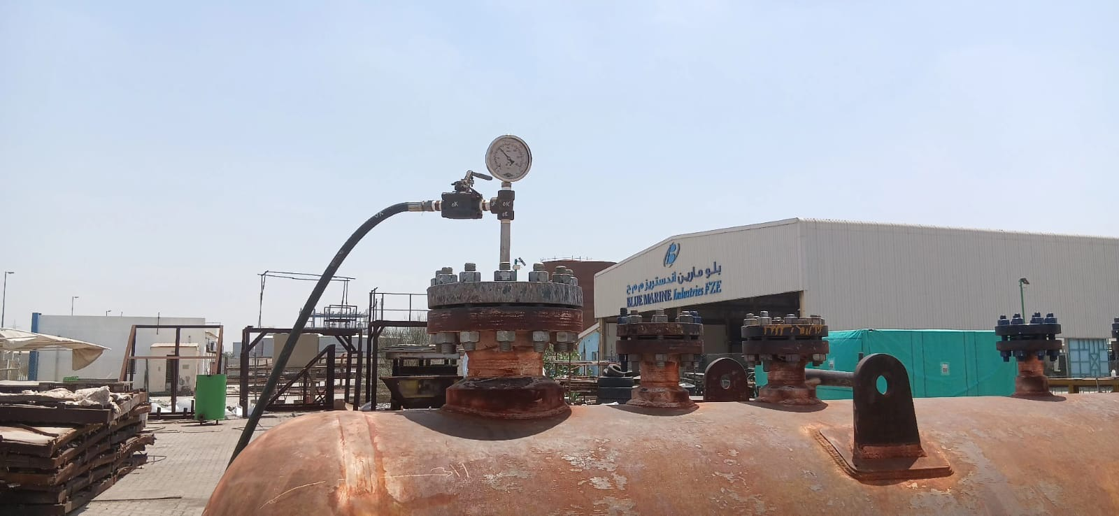
Supply Chain Capability
Our procurement team manages global sourcing and local vendor integration to ensure timely delivery of materials, equipment, and long-lead items. Established relationships with OEMs across Europe, United Kingdom, Asia, North America, and the Middle East — combined with a structured vendor qualification process — underpin schedule certainty on every project.

Slide 17
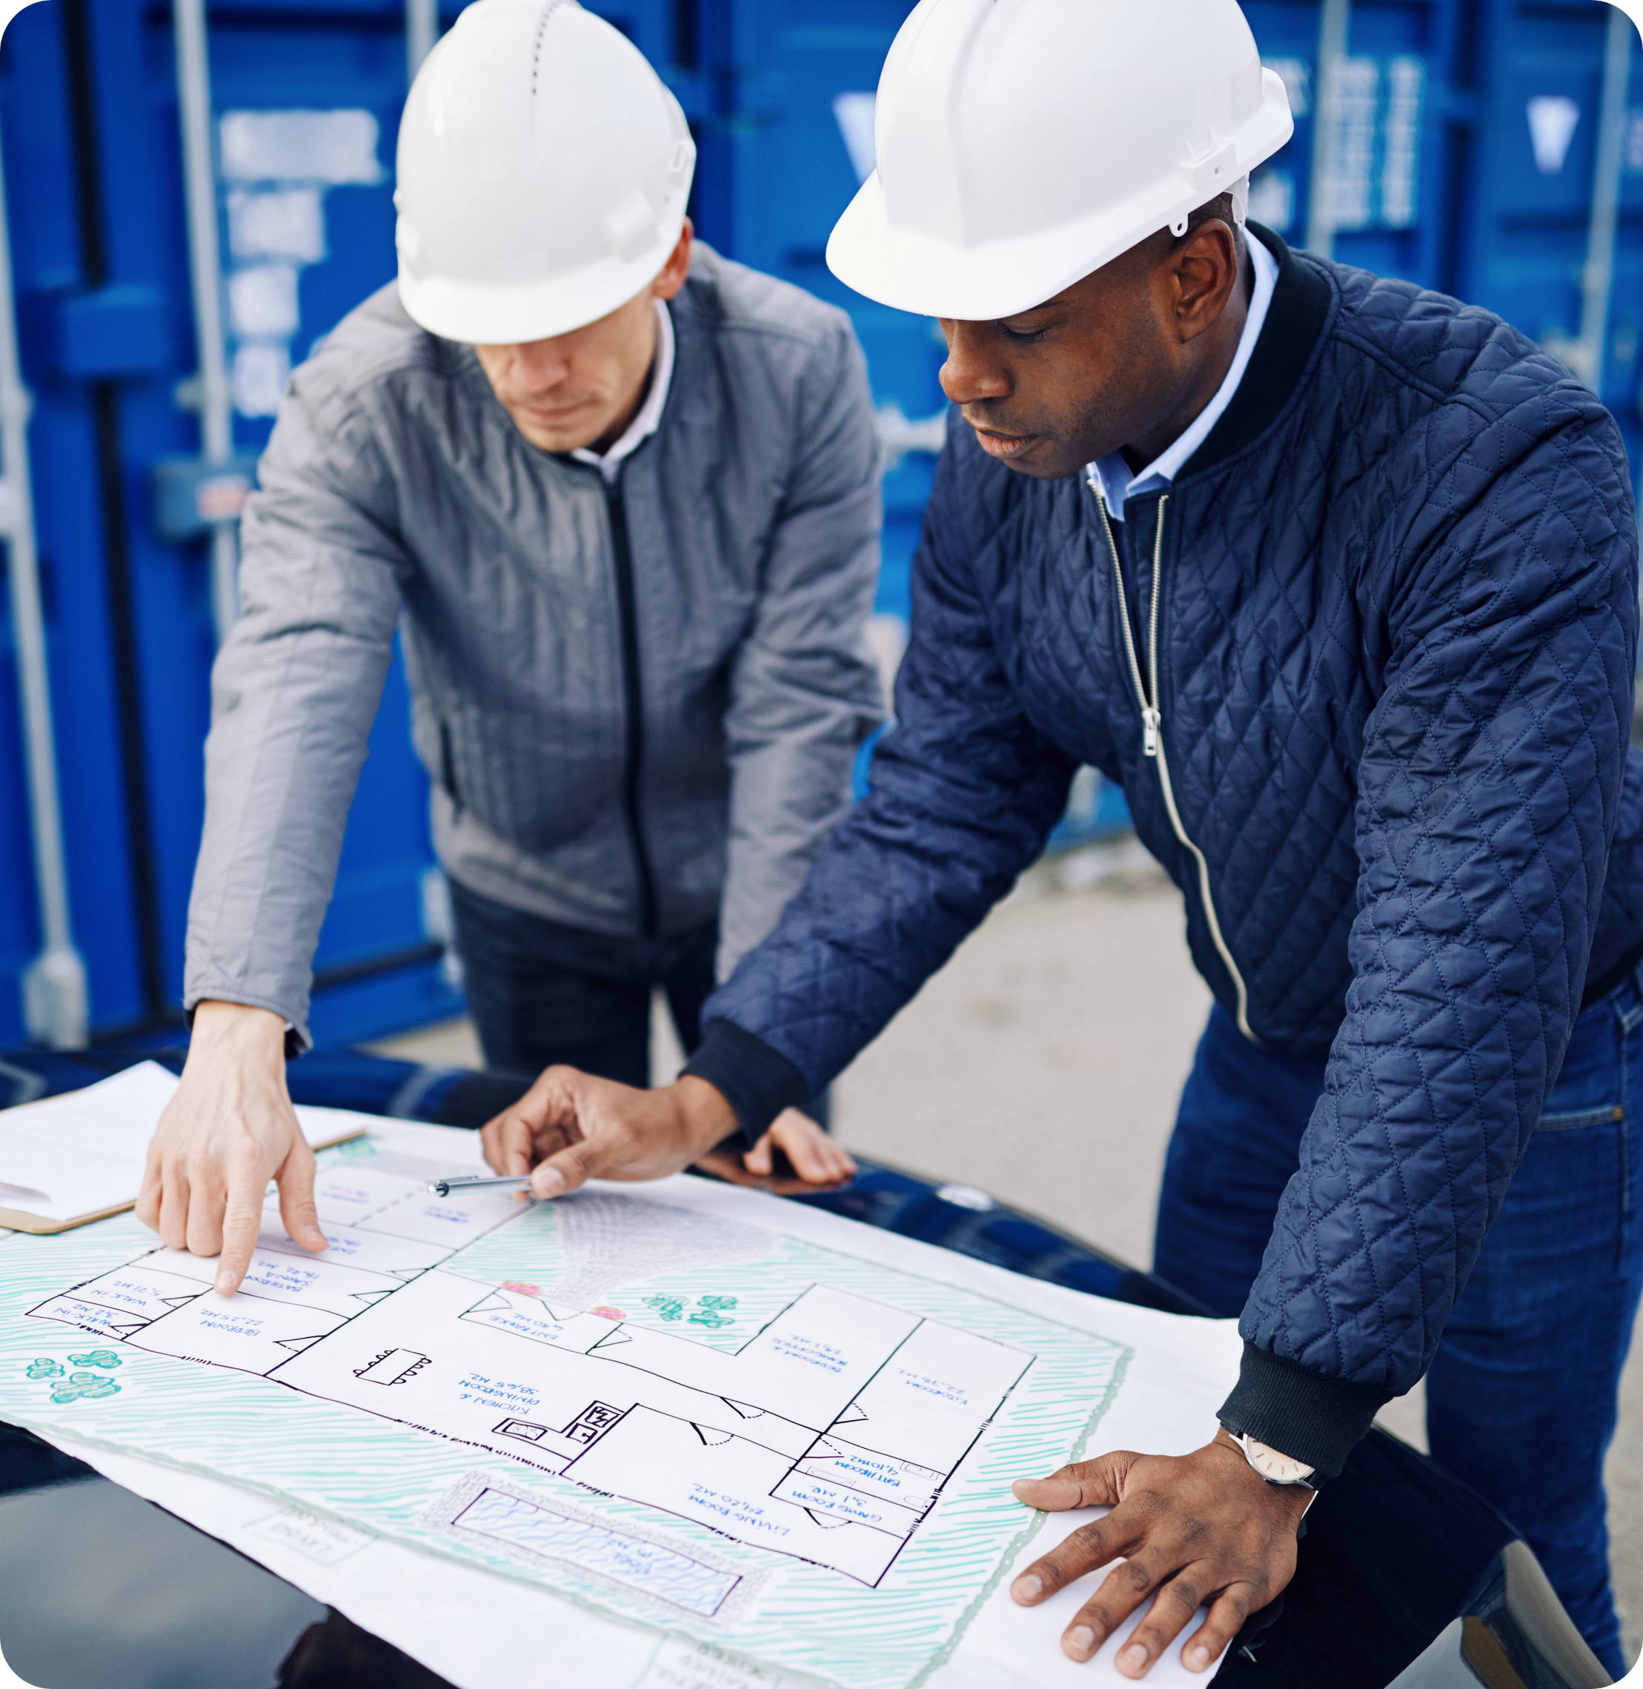
Key EPF Projects
30,000
Belema Re-entry EPF (Renaissance Africa Energy Company, 2025 - 2026)
BLPD —Peak Single EPF Capacity Delivered
Concept development, engineering, and construction support for modular process facilities mobilised to site in a record 12 weeks from contract award.
Abiala EPF (Elcrest / Naphta JV, 2024–2025)
Engineering and commissioning support delivering accelerated first oil.

Slide 18






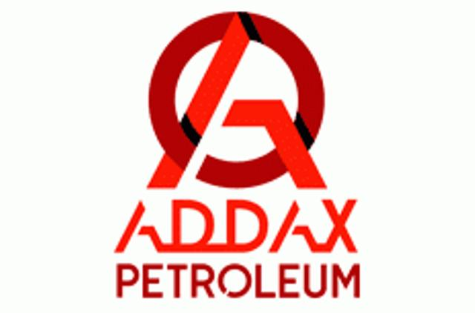





Key Clients

Slide 19
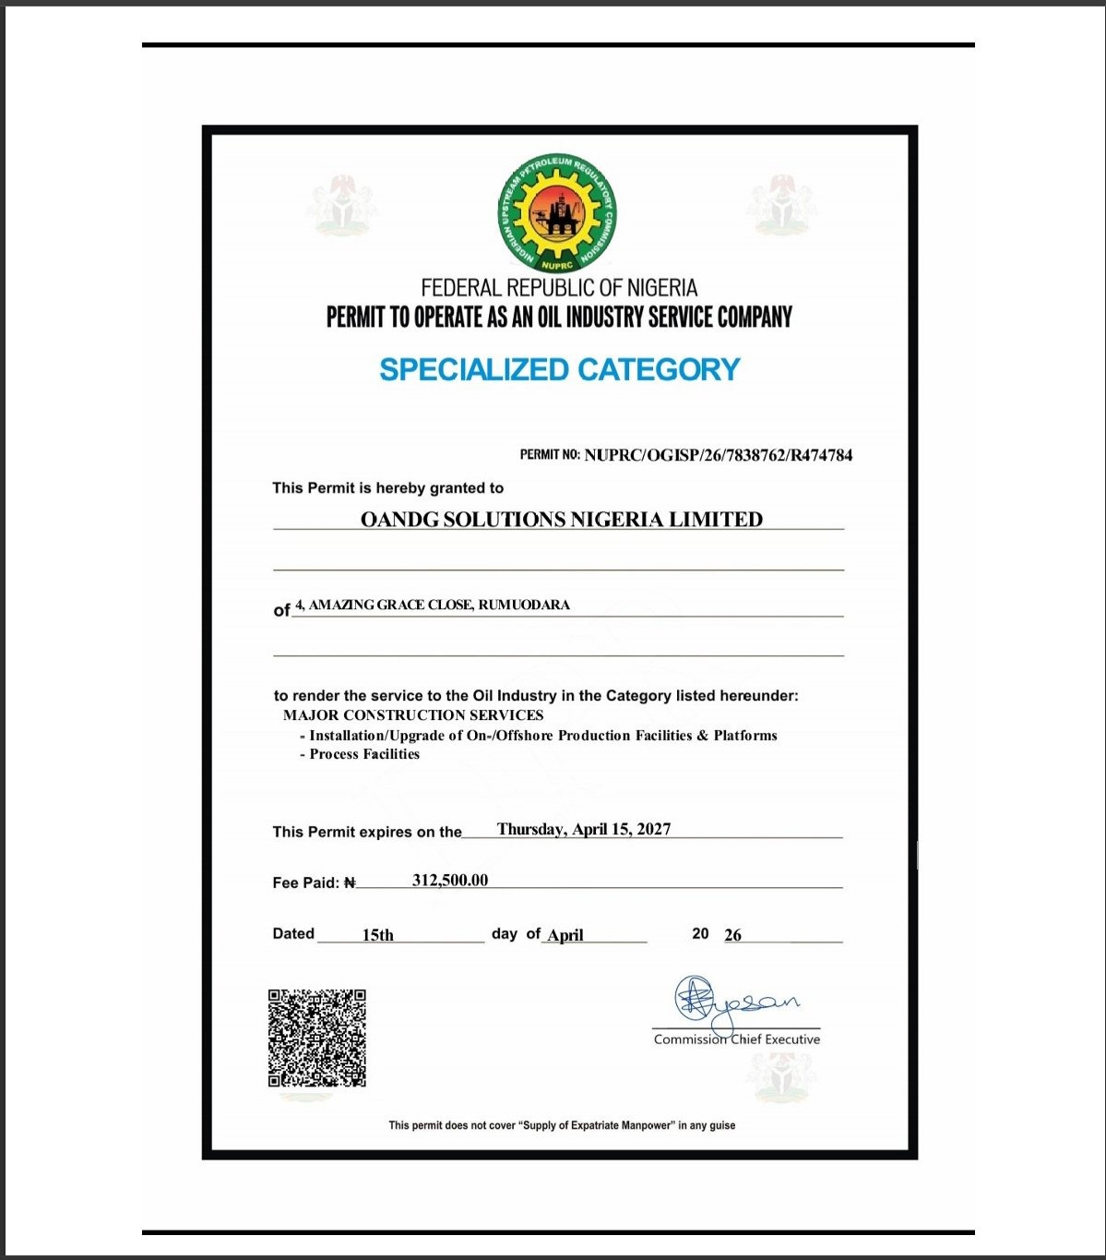

Permits & Certification
O&G Solutions adheres to the highest industry standards and maintains compliance with NUPRC regulatory requirements. Equipment is delivered with DNV 2.7-1 and ASME U-Stamp certification, supported by ISO 9001, ISO 14001, and ISO 45001 aligned management systems.
MAJOR CONSTRUCTION SERVICES
TECHNICAL CONSULTANCY

Slide 20
Sustainability & ESG
We are committed to environmentally responsible operations, community development, and ethical governance. Our engineering decisions prioritise energy efficiency, responsible process design, and reduced emissions.
Low-Emissions Process Design
Safety-First Culture
Local Workforce & Community Impact
Certified Governance
VFD systems and process optimization that reduce operator energy consumption and operational emissions.
ISO 45001 & ISO 14001 aligned management systems with 5-year zero LTI track record across all operations.
Nigerian content commitment driving in-country fabrication, qualified employment, and long-term sector development.
DNV 2.7-1 and ASME U-Stamp certification, full regulatory compliance, and transparent stakeholder engagement.

Slide 21





Financial Information
O&G Solutions maintains a stable financial position, supported by structured capital management, CAPEX discipline, and project accounting processes aligned with best financial practices.
BANKERS
GT Bank PLC
Fidelity Bank PLC
First Bank of Nigeria PLC
Financial
Advisors
&
Auditors

Slide 22
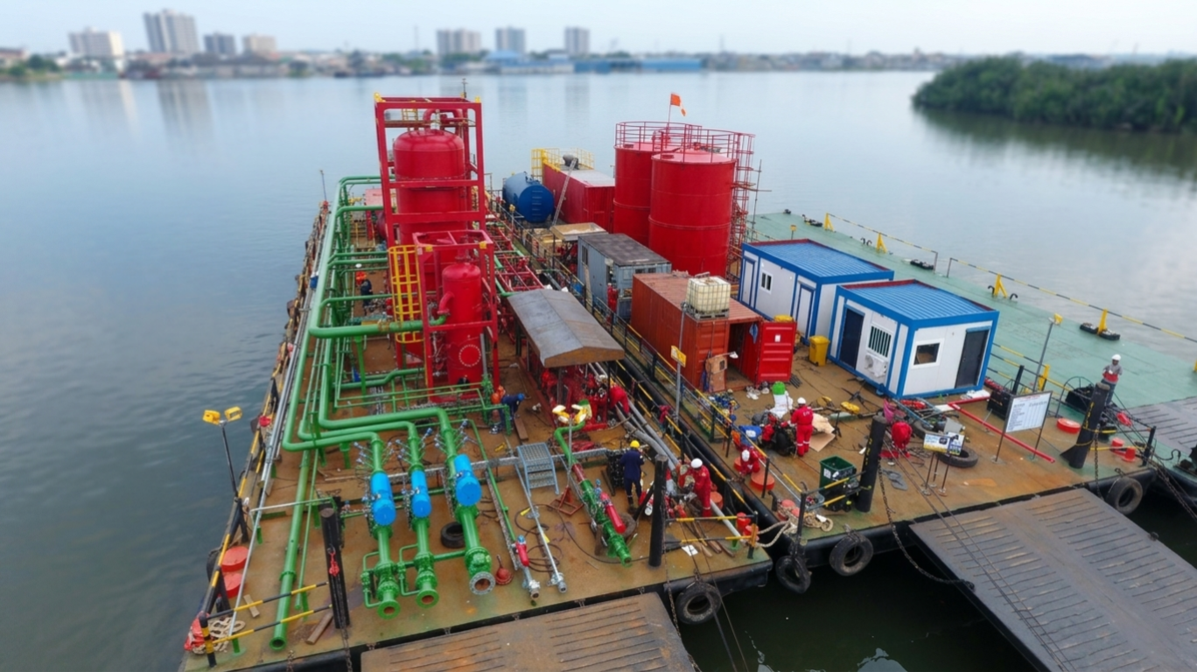
Why O&G Solutions
Proven EPF Specialist
Speed to First Oil
Focused specialists in EPF and modular process systems integrator — not a general contractor.
Modular execution, parallel engineering, and early procurement compress schedules and accelerate first oil.
Dual-Region Delivery
Proven HSE & Quality Delivery
Nigerian execution combined with UAE fabrication — closer to clients, supply chains, and projects.
Five years zero LTI, ISO 9001/14001/45001 aligned systems, and DNV 2.7-1 certified equipment.

Slide 23
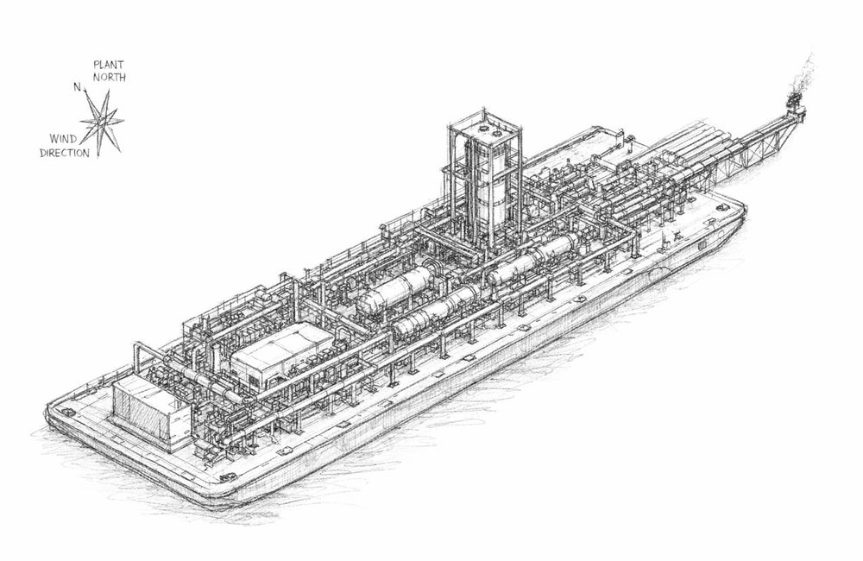
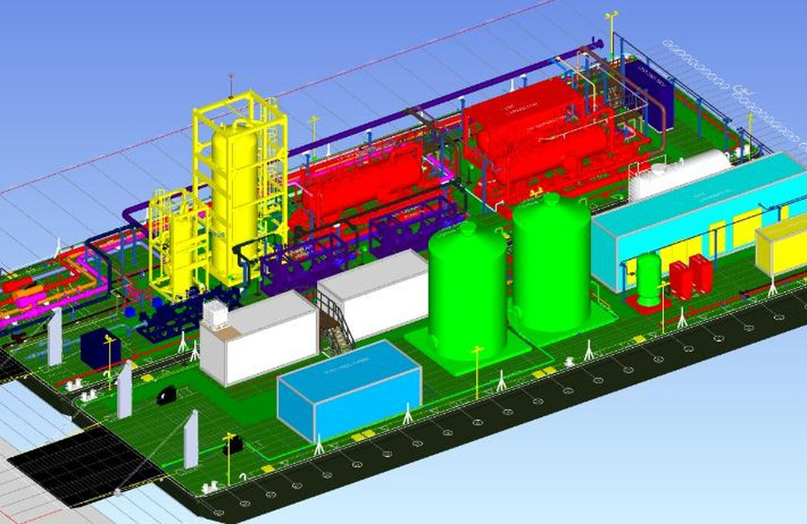
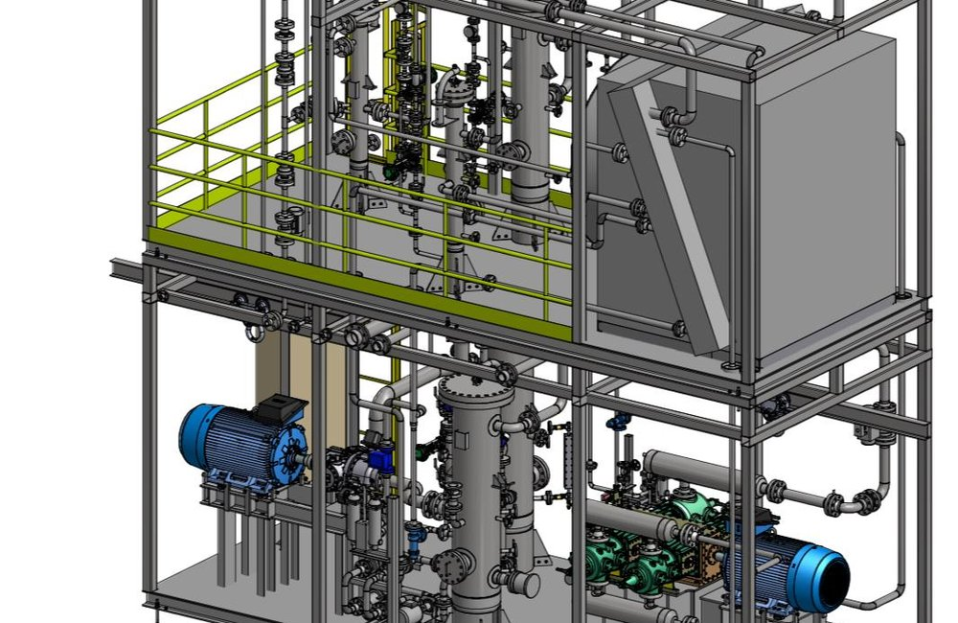
From Concept to 3D Model
Every EPF starts on paper and is developed into a detailed 3D model before fabrication begins.

Slide 24
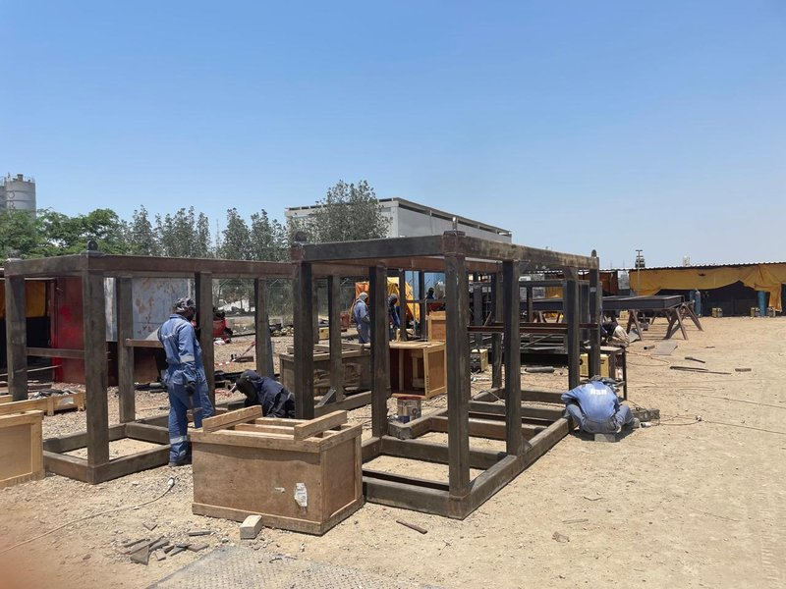
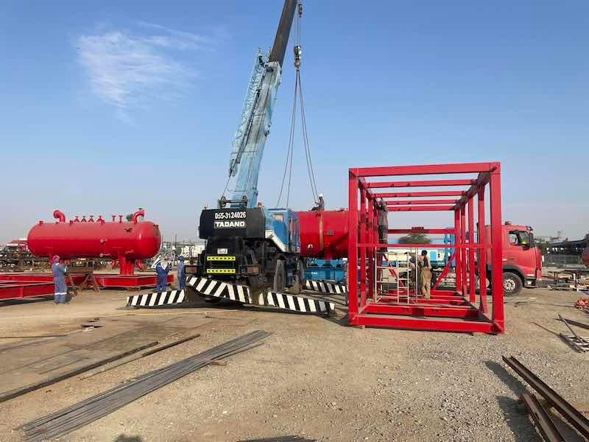
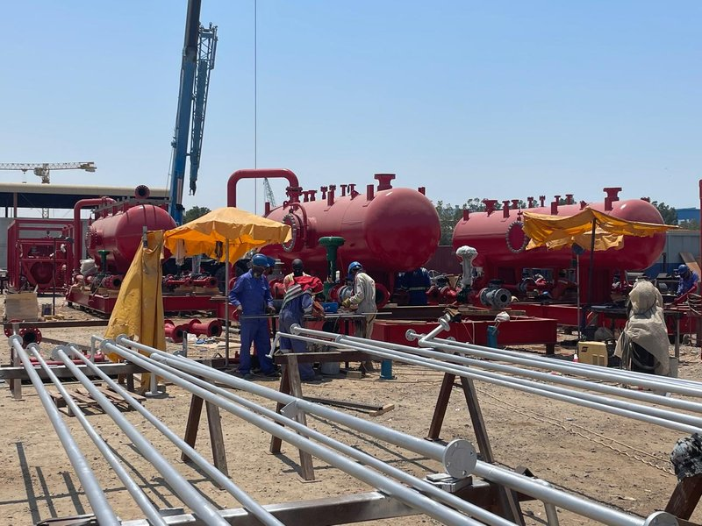
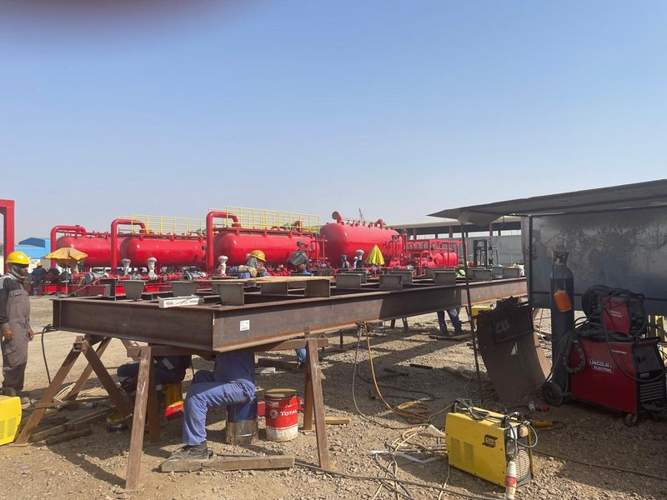
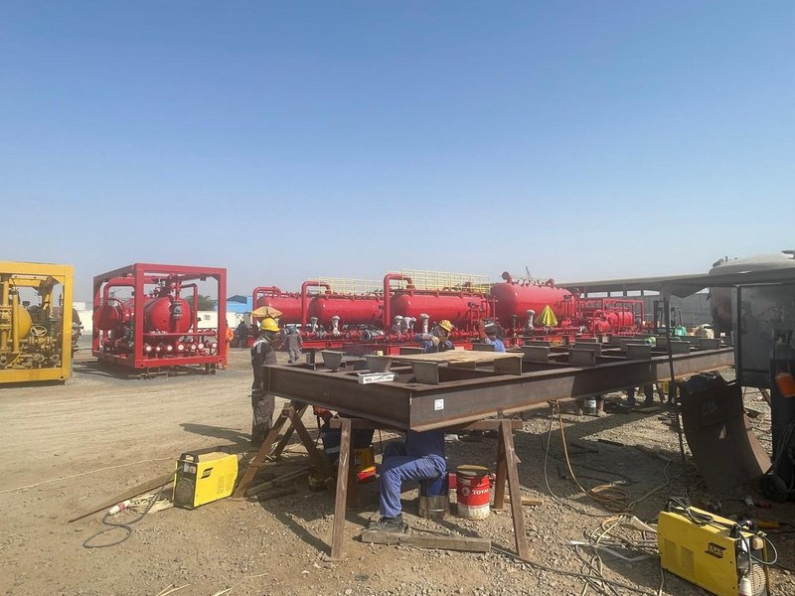
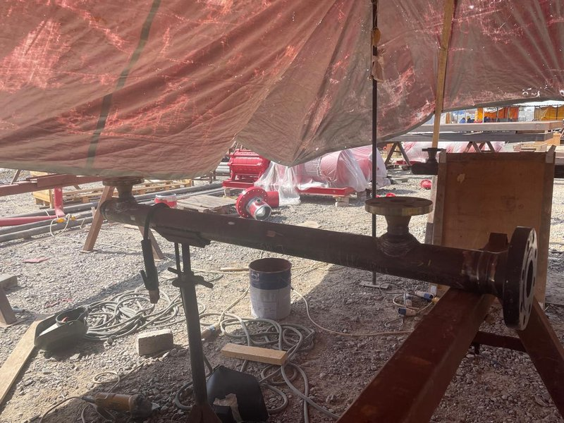
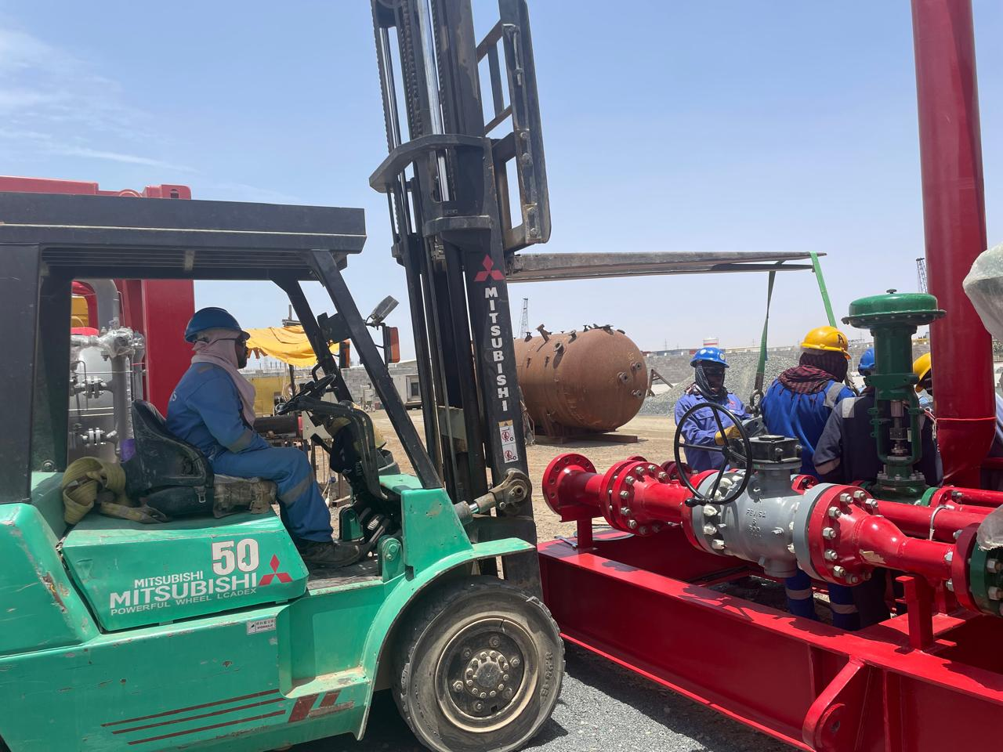
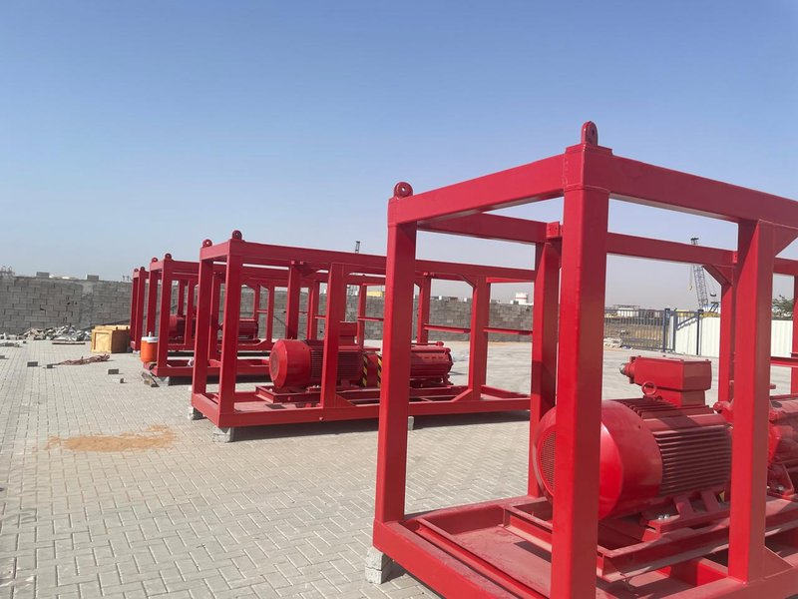
Early Construction Phase
In-house fabrication across our Nigeria and UAE yards — from steel cutting to final assembly.

Slide 25
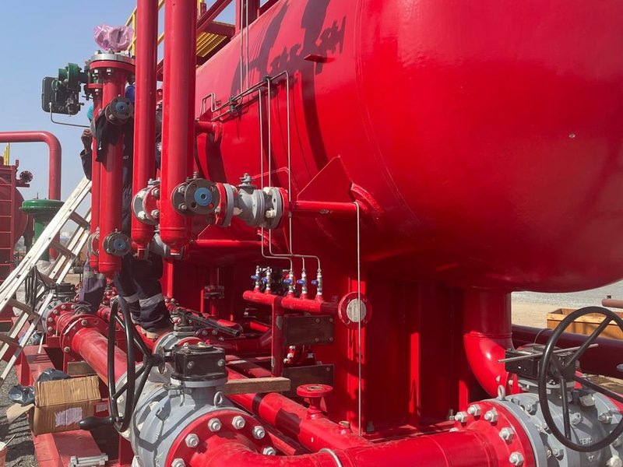
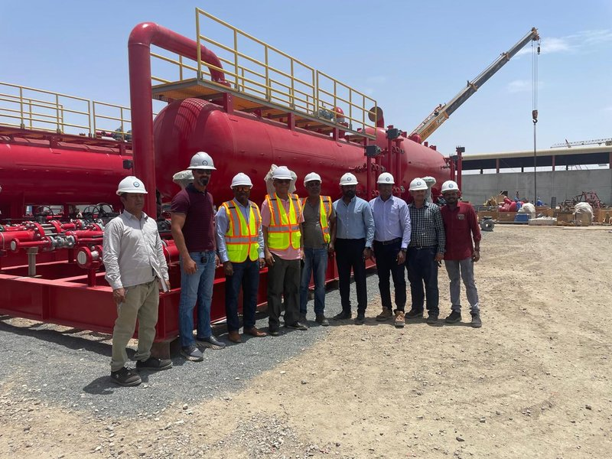
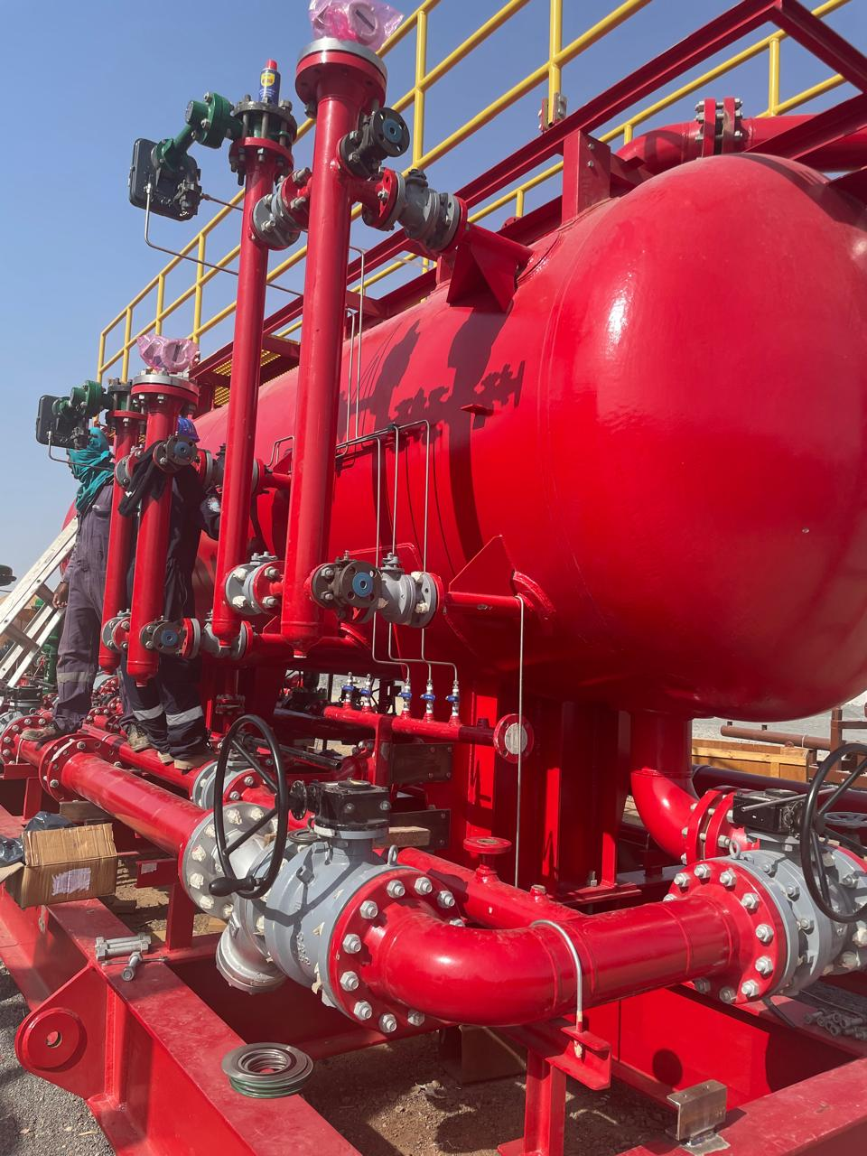
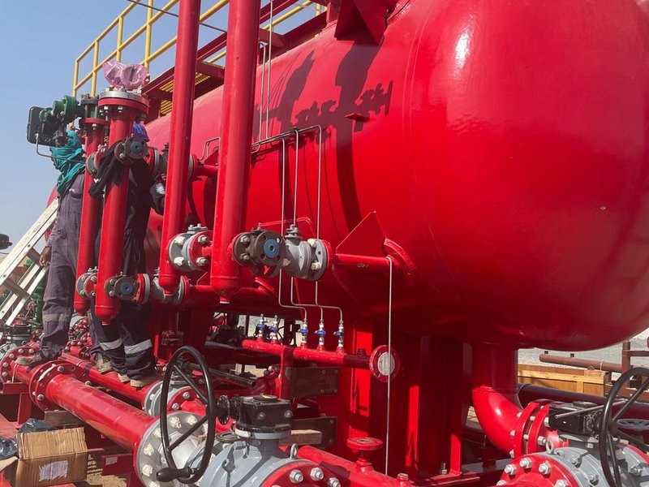
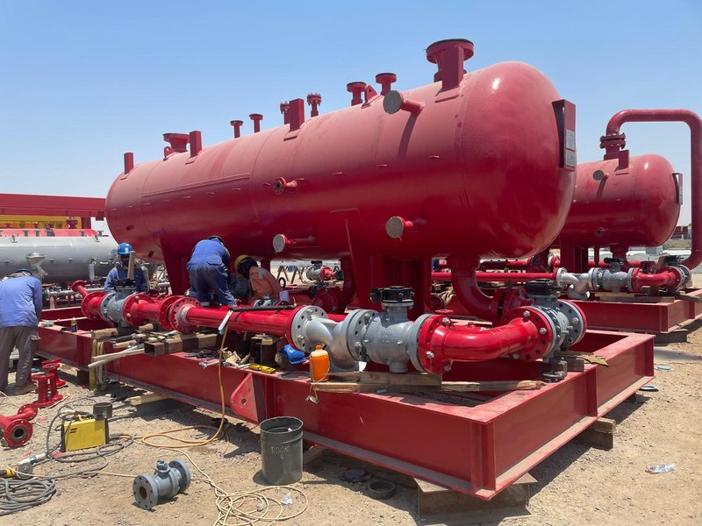
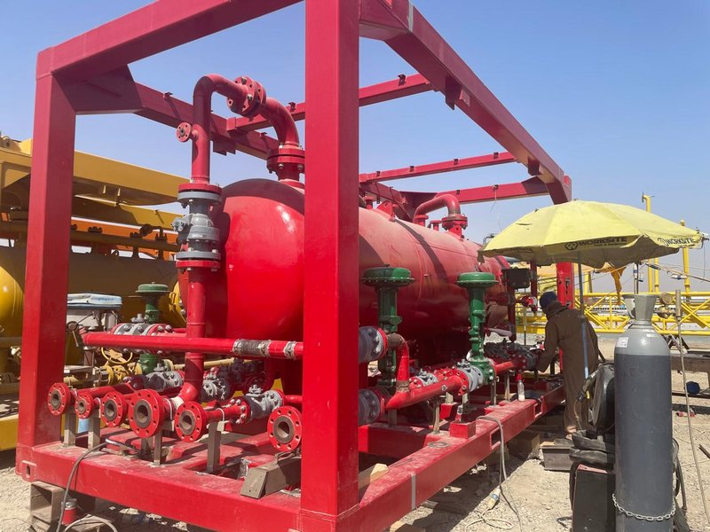
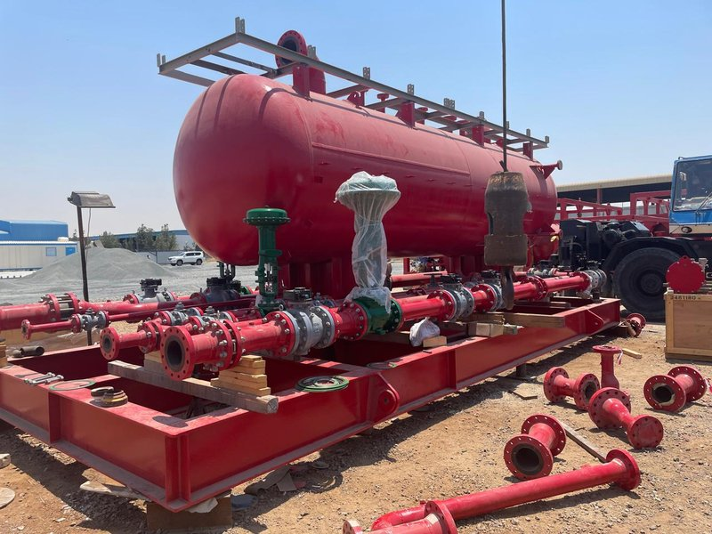
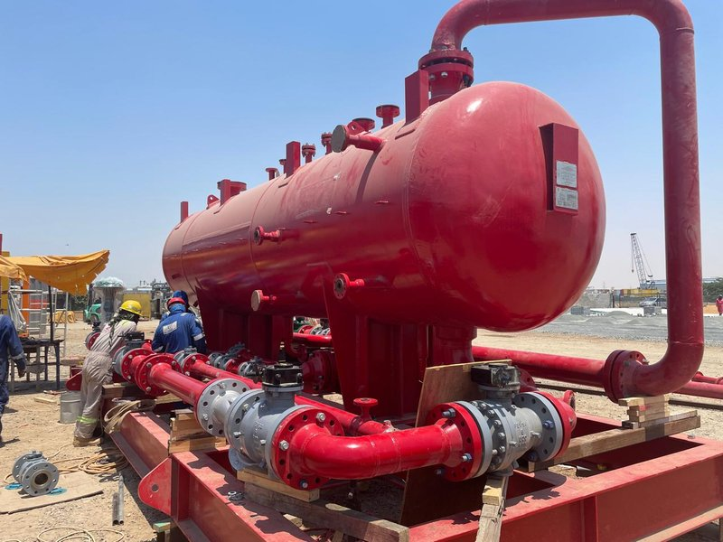
Advanced Construction Phase
EPF packages and the team that built them — well on the way to full site deployment.

Slide 26
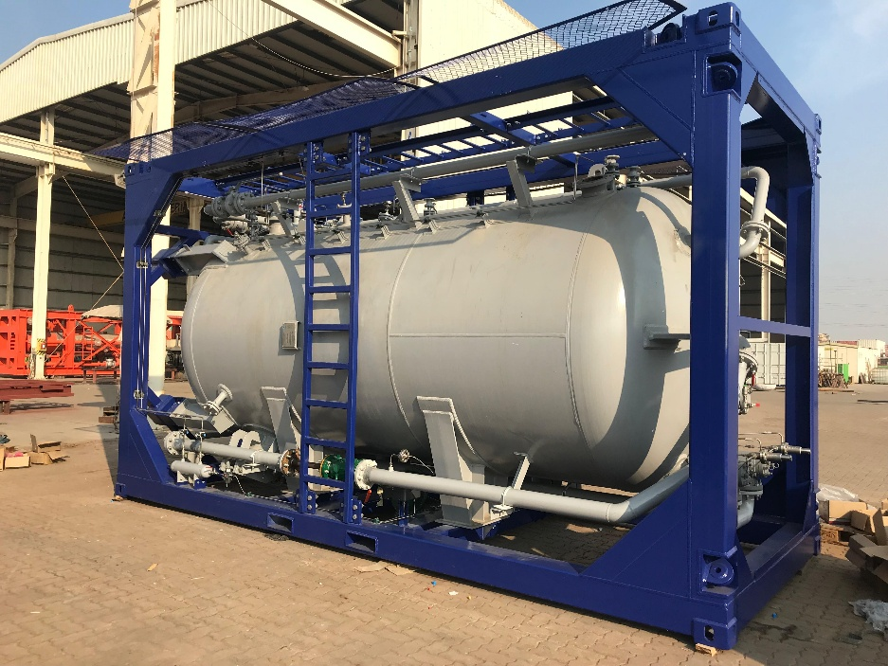
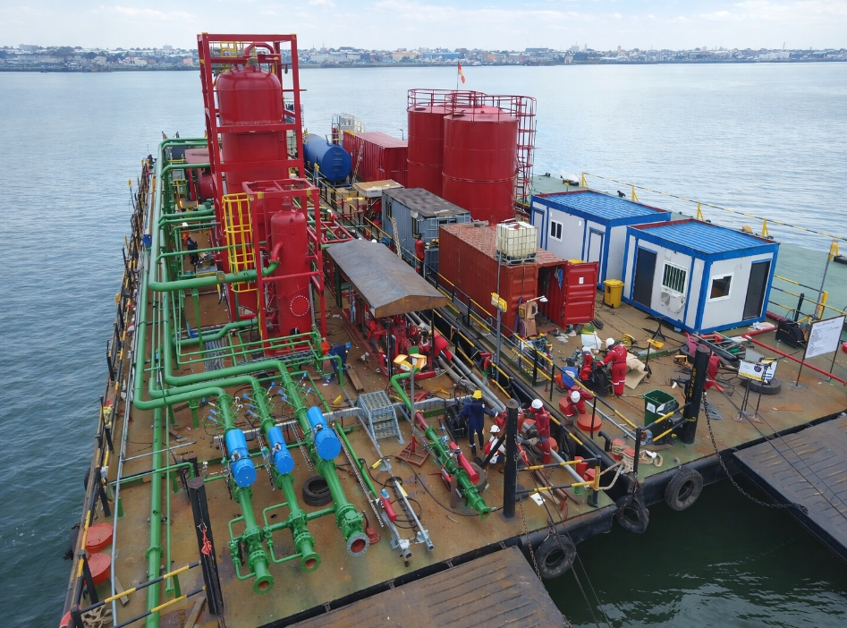
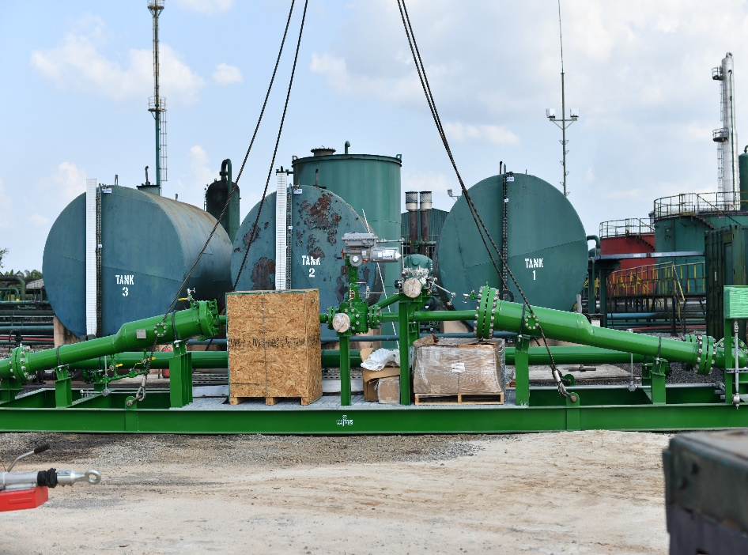
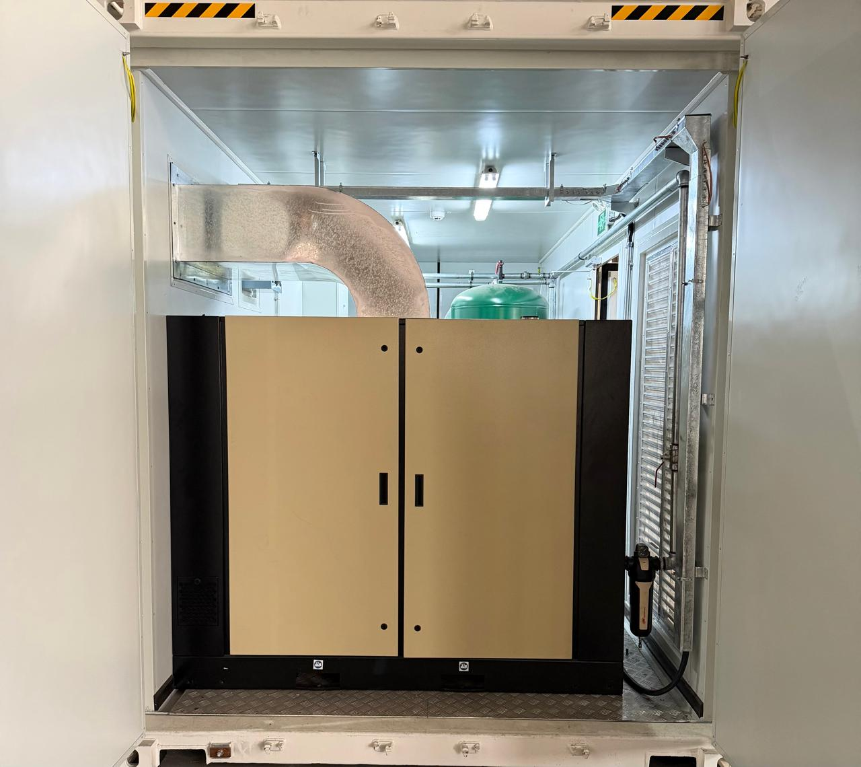
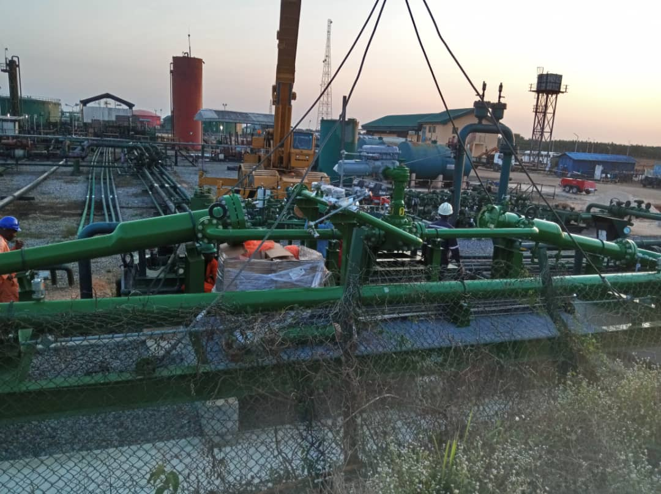
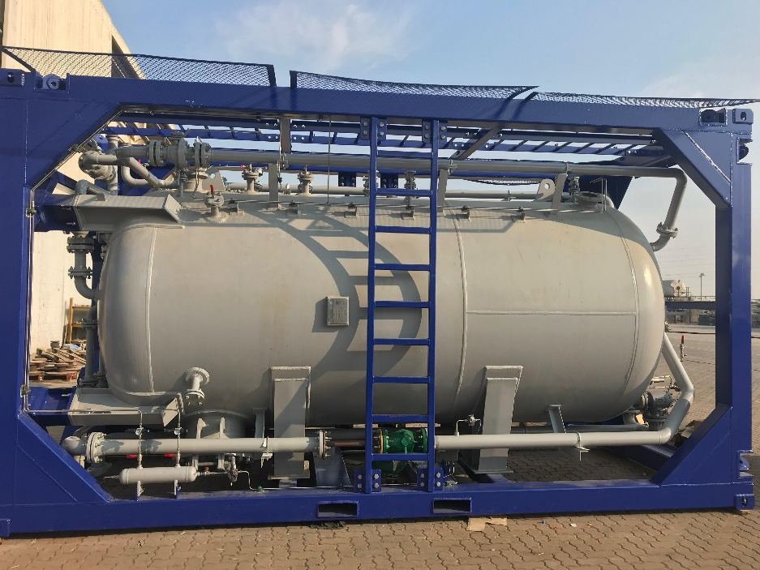
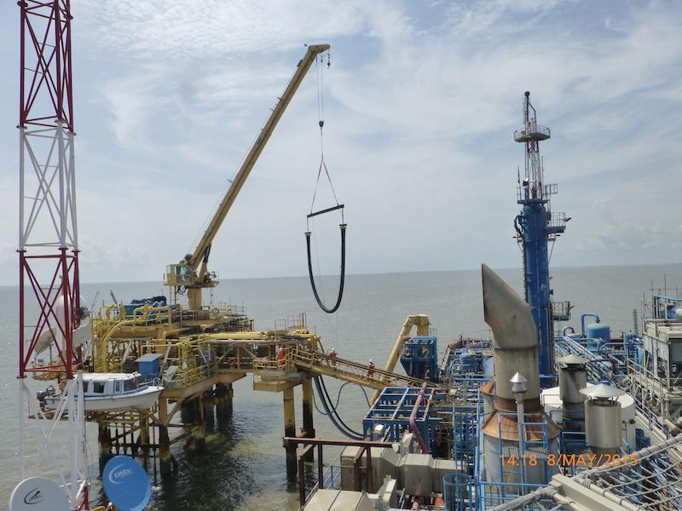
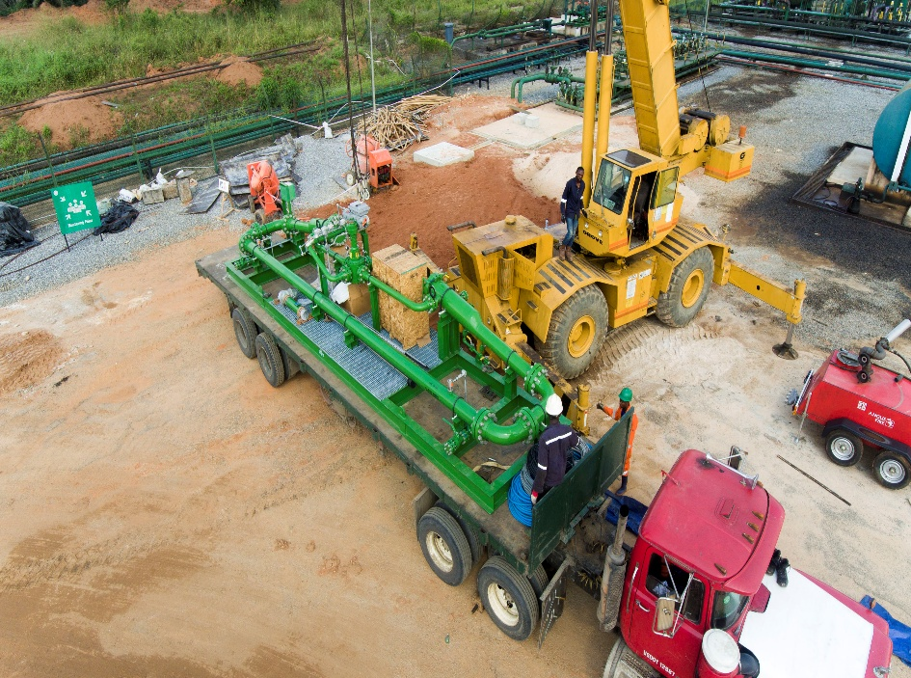
Other Projects
We’ve executed on world class facilities and equipments with our partners globally

Slide 27
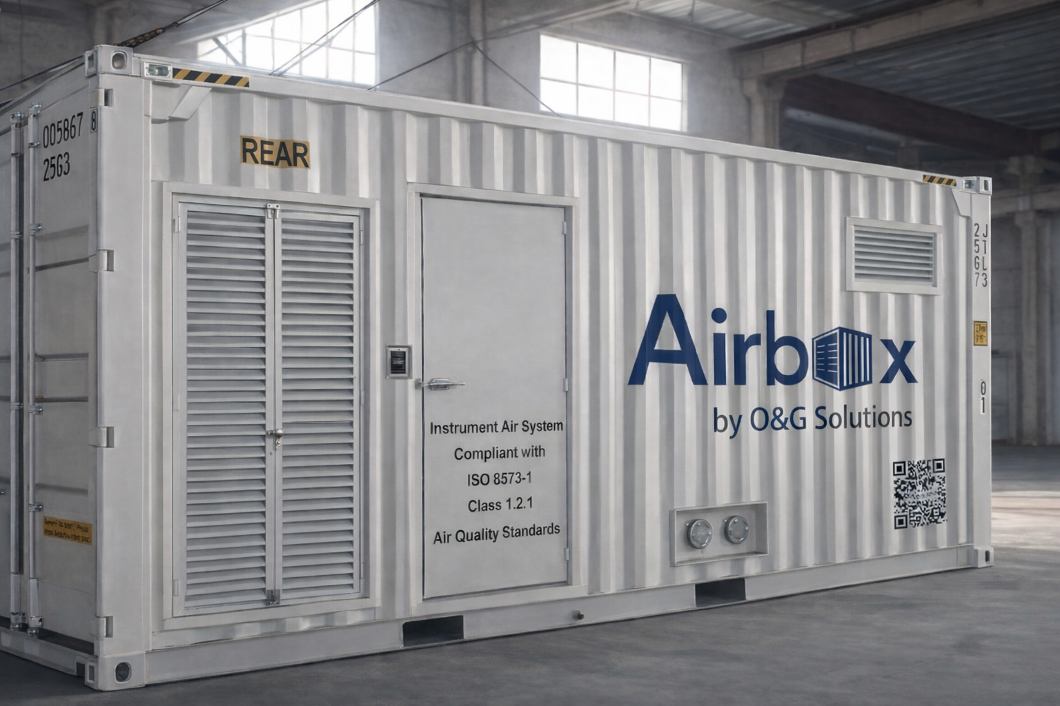

For a better energy future
To discuss your project requirements or request a technical proposal, contact Patrick Akpobome and the O&G Solutions team. We operate out of Port Harcourt, Nigeria and the UAE.
sales@oandg-solutions.com
www.oandg-solutions.com
+234 8035201161
+234 906 378 6490

